Slide 1

Mini Project Final Review Presentation on Detection of Legitimate Transaction using ML Approach
SIDDAGANGA INSTITUTE OF TECHNOLOGY, TUMKUR
Department of Infromation Science and Engineering
Under the guidance of
Ms. Vishala G,
Assistant Professor
Dept. of ISE, SIT, Tumakuru.
By
Manoj Gowda B G : 1SI20IS026

Slide 2
OUTLINE
Contents
Introduction
Problem statement
Objectives
Literature Survey
Dataset Overview
Proposed Work
Block Diagram of Proposed Work
System Architecture
System Workflow
Comparison Table
Confusion Metrix
Applications
Results
Conclusion
Future Scope
References
2
Dept. of ISE, SIT, Tumkur

Slide 3
INTRODUCTION
Introduction
Online transactions are growing rapidly, increasing the risk of financial fraud.
Traditional rule-based methods struggle to detect sophisticated fraud patterns.
Delays in detecting fraud lead to financial losses for consumers and organizations.
Machine Learning (ML) offers advanced capabilities to analyze transaction patterns and identify fraud effectively.
This project uses ML algorithms to classify transactions as legitimate or fraudulent in real time.
The system aims to improve accuracy, reduce false positives, and enhance security in financial transactions.
3
Dept. of ISE, SIT, Tumkur

Slide 4
PROBLEM STATEMENT
Problem statement
With the increasing number of online transactions, detecting fraud has become a major challenge. This project uses machine learning to quickly and accurately classify transactions as either legitimate or fraudulent, improving security and reducing financial losses.
4
Dept. of ISE, SIT, Tumkur

Slide 5
OBJECTIVES
Objective
Use advanced machine learning techniques to detect complex and evolving fraud patterns in real-time, ensuring prompt intervention during online transactions.
Focus on improving the accuracy of fraud detection while minimizing false positives, ensuring seamless transaction processing without disrupting legitimate users.
Develop a scalable system that adapts to changing fraud tactics, maintaining its effectiveness and reliability over time as fraudulent methods evolve.
Dept. of ISE, SIT, Tumkur
5

Slide 6
LITERATURE SURVEY
Literature Survey
SI. NO | TITLE | SUMMARY | SOURCE | LIMITATIONS | OUTCOME
1] | An Ensemble Method for Credit Card Fraud Detection | This study proposes an ensemble approach combining various classifiers to improve detection rates of fraudulent transactions, achieving 96% accuracy. | IEEE Xplore | The model's complexity may lead to longer processing times and requires extensive tuning. | Obtained 96% accuracy.
Dept. of ISE, SIT, Tumkur
6

Slide 7
LITERATURE SURVEY
Literature Survey
SI. NO | TITLE | SUMMARY | SOURCE | LIMITATIONS | OUTCOME
2] | Deep Learning for Fraud Detection in Financial Transactions | Explores the use of deep learning techniques, particularly LSTM networks, to detect fraudulent activities in real-time with an accuracy of 94%. | IEEE Xplore | The dependency on high-quality data limits its applicability in environments with poor data quality. | Obtained 94% accuracy.
Dept. of ISE, SIT, Tumkur
7

Slide 8
LITERATURE SURVEY
Literature Survey
SI. NO | TITLE | SUMMARY | SOURCE | LIMITATIONS | OUTCOME
3] | Fraud Detection Using Machine Learning Techniques | Utilizes various machine learning algorithms, including SVM and Random Forest, to identify fraudulent transactions with a detection accuracy of 91%. | IEEE Xplore | The need for ongoing model retraining to maintain effectiveness against evolving fraud patterns. | Obtained 91% accuracy.
Dept. of ISE, SIT, Tumkur
8

Slide 9
LITERATURE SURVEY
Literature Survey
SI. NO | TITLE | SUMMARY | SOURCE | LIMITATIONS | OUTCOME
4] | A Survey on Financial Fraud Detection Techniques | Provides a comprehensive review of existing fraud detection methods, comparing their performance and applicability in different financial contexts. | Google Scholar | Limited focus on practical implementations; mainly theoretical analysis of existing methods. | Comprehen--sive understandi-ng of the field.
Dept. of ISE, SIT, Tumkur
9

Slide 10
LITERATURE SURVEY OUTCOME
Literature Survey Outcome
Effectiveness of Machine Learning in Fraud Detection: ML techniques outperform traditional rule-based systems by learning complex and evolving fraud patterns. Algorithms such as decision trees, neural networks, and ensemble models provide higher accuracy in fraud detection.
Challenges in Fraud Detection: The imbalanced nature of transaction datasets, where fraudulent cases are significantly fewer, requires specialized techniques such as oversampling, undersampling, and synthetic data generation. Balancing detection accuracy while minimizing false positives is crucial to avoid unnecessary disruptions for legitimate users.
Importance of Feature Engineering: Preprocessing techniques like Principal Component Analysis (PCA) help in reducing dimensionality and improving detection efficiency. Selecting the right features, such as transaction time, amount, and user behavior patterns, enhances model performance.
Dept. of ISE, SIT, Tumkur
10

Slide 11
DATASET OVERVIEW
Dataset Overview
The dataset contains credit card transactions from European cardholders, with the goal of detecting fraud.
It has:
492 frauds out of 284,807 transactions (0.172% fraud rate).
Features are PCA-transformed, except for Time (elapsed time since the first transaction) and Amount (transaction amount).
The target variable Class indicates whether a transaction is fraud (1) or not (0).
Imbalanced dataset, so we have to balance it to perform the fraud detection operation.
Dept. of ISE, SIT, Tumkur
11

Slide 12
BLOCK DIAGRAM OF PROPOSED WORK
Proposed Work
Feature Extraction & Selection
ML Model (Training & Prediction)
Fraud Classification(Legit/Fraudulent)
User Transaction Input
Data Preprocessing(Cleaning, Scaling)
Alert System(Trigger Notification)
Fig. Block Diagram of
Proposed Work
Notify User/Bank via SMS/Email
Dashboard System (Monitor Alerts)
Dept. of ISE, SIT, Tumkur

Slide 13
SYSTEM ARCHITECTURE
System Architecture
User Interface (Web/Mobile App)
API Gateway / Middleware
Fraud Detection Engine
Feedback System (Retraining)
Dashboard View
Alerts System
Deployment Layer (Cloud)
Data Layer (DB, Preprocessing)
Notification Service (SMS/Email)
Dept. of ISE, SIT, Tumkur

Slide 14
SYSTEM WORKFLOW
System Workflow
Data Layer(Data Sources, Data Storage, Preprocessing)
Model Development Layer(Feature Engineering, ML Models, Model Ealuatiion)
Detection Layer(Fraud Detection System, Real Time Processing, Alert Mechanism)
Deployment Layer(Infrastructure, Containerization)
Feedback and Refinement Layer(User Feedback, Model Updates)
Integration Layer(API Services, Real Time Dashboard)
Dept. of ISE, SIT, Tumkur

Slide 15
COMPARISON TABLE
Comparison Table
Algorithm | Type | Key Features | Advantages | Disadvantages | Logistic Regression
[1] Logistic Regression | Linear Model | Binary classification, interpretable coefficients | Simple, interpretable, efficient for small datasets | Assumes linearity, struggles with complex, high-dimensional data; lower test aaccuracy | Accuracy: 97.05% (Train), 92.21% (Test)
[2] Random Forest | Ensemble, Decision Trees | Uses multiple decision trees, random sampling, handles feature importance | Robust to overfitting, handles missing data well | Computationally expensive; similar test accuracy to Logistic Regression | Accuracy: 100% (Train), 92.21% (Test)
Dept. of ISE, SIT, Tumkur
15

Slide 16
COMPARISON TABLE
Comparison Table
Algorithm | Type | Key Features | Advantages | Disadvantages | Logistic Regression
[3] XGBoost (Preferred) | Boosting, Ensemble | Gradient boosting framework, handles imbalanced datasets with scale_pos_weight | High accuracy, robust to non-linear patterns, best test performance | Computationally intensive but achieves the best test accuracy | Accuracy: 100% (Train), 93.51% (Test) (Best)
[4] Decision Tree | Decision Trees | Rule-based classification, interpretable, splits data hierarchically | Simple, interpretable, fast to train | Prone to overfitting, lowest test accuracy of all models | Accuracy: 100% (Train), 89.61% (Test)
Dept. of ISE, SIT, Tumkur
16

Slide 17
CONFUSION METRIX
Confusion Metrix
Algorithm | Accuracy | Precision (Class 1) | Recall (Class 1) | F1-Score (Class 1) | Precision (Class 0) | Recall (Class 0) | F1-Score (Class 0)
Logistic Regression | 92.21% | 0.36 | 0.72 | 0.48 | 0.97 | 0.88 | 0.93
Random Forest | 92.21% | 0.76 | 0.64 | 0.70 | 0.97 | 0.98 | 0.97
XGBoost(Prefered) | 93.51% | 0.79 | 0.76 | 0.78 | 0.98 | 0.98 | 0.98
Decision Tree | 89.61% | 0.44 | 0.44 | 0.44 | 0.95 | 0.95 | 0.95
Dept. of ISE, SIT, Tumkur
17

Slide 18
APPLICATION
Application
Financial Institutions: Implement real-time fraud detection systems to identify and mitigate fraudulent transactions across banking, credit card, and payment systems, enhancing customer trust and security.
E-Commerce Platforms: Utilize machine learning algorithms to monitor transactions, preventing chargebacks and losses while improving user experience through reduced false positives.
Insurance Companies: Apply fraud detection models to claims processing, identifying suspicious patterns to reduce fraudulent claims and enhance operational efficiency.
Regulatory Compliance: Aid organizations in adhering to Anti-Money Laundering (AML) and Know Your Customer (KYC) regulations by employing advanced analytics to monitor transactions for suspicious activity.
Risk Assessment: Integrate AI-driven solutions to evaluate risk profiles of customers and transactions, allowing organizations to make informed decisions and minimize exposure to fraud.
18
Dept. of ISE, SIT, Tumkur

Slide 19
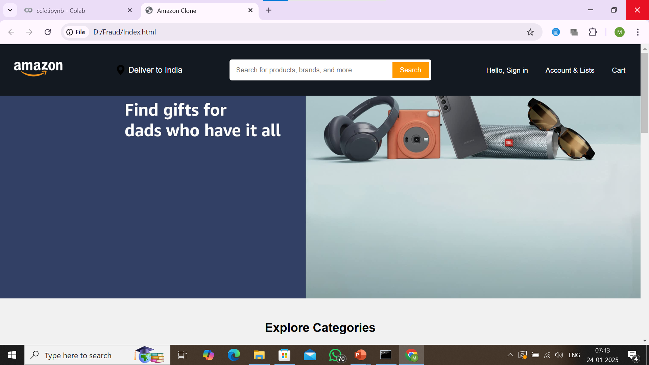
RESULTS
Results
1. Cloned Website Overview
19
Dept. of ISE, SIT, Tumkur

Slide 20

RESULTS
Results
2. Buying the product
20
Dept. of ISE, SIT, Tumkur

Slide 21
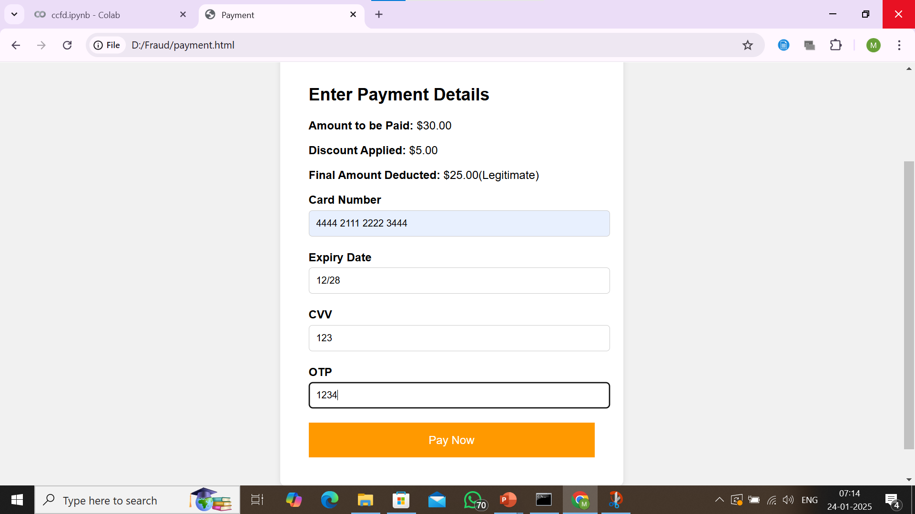
RESULTS
Results
3.Making the payment through credit card
21
Dept. of ISE, SIT, Tumkur

Slide 22
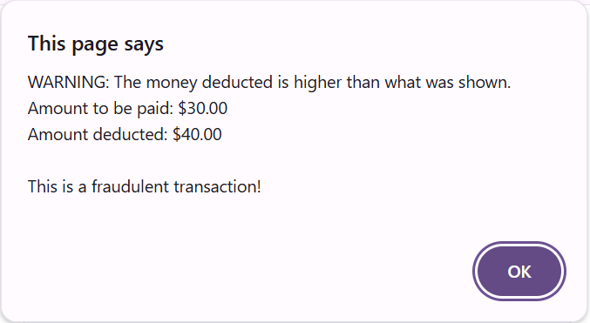
RESULTS
Results
4. Credit Card Fraud Happend
22
Dept. of ISE, SIT, Tumkur

Slide 23
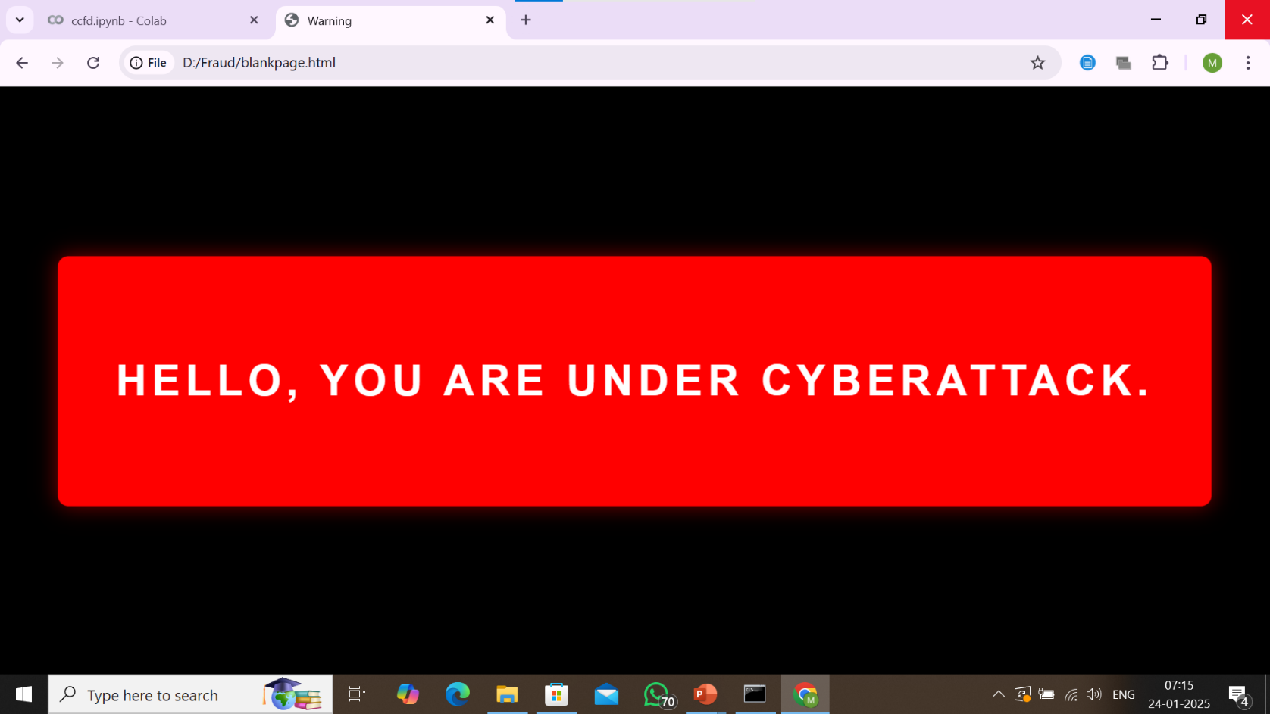
RESULTS
Results
5. Credit Card Fraud Happened Message
23
Dept. of ISE, SIT, Tumkur

Slide 24
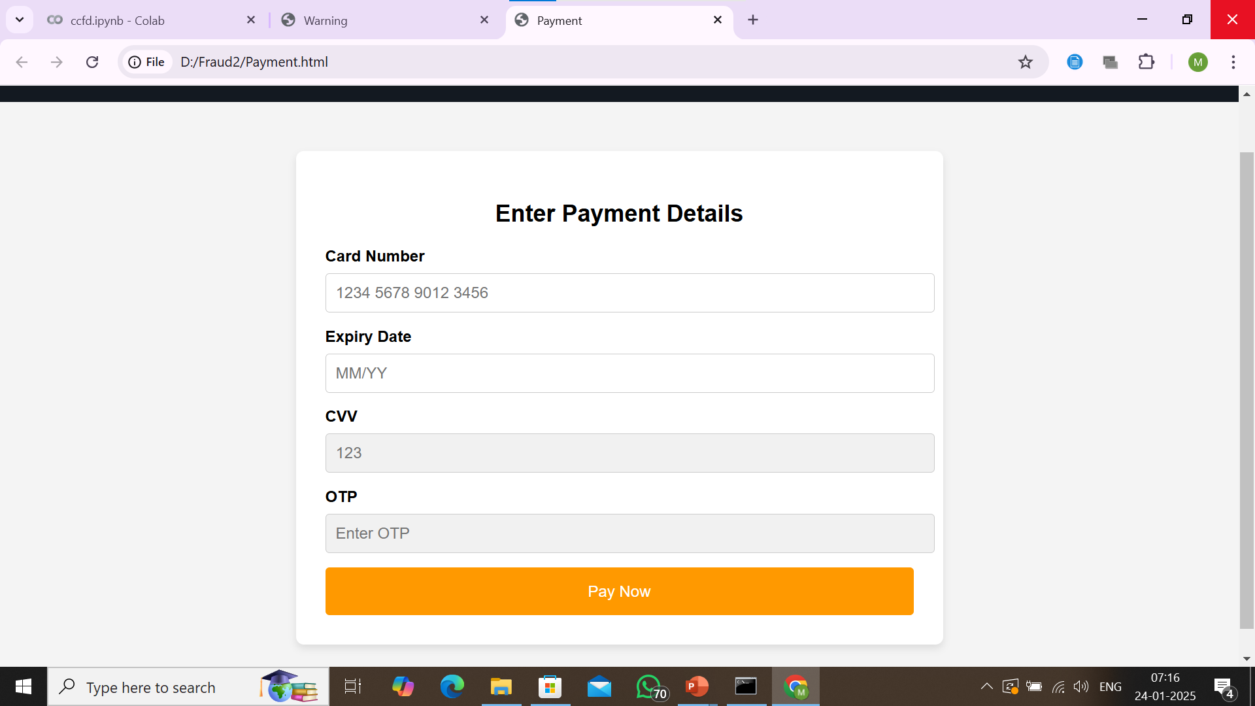
RESULTS
Results
5. Checking the Fraudulent Activity
24
Dept. of ISE, SIT, Tumkur

Slide 25
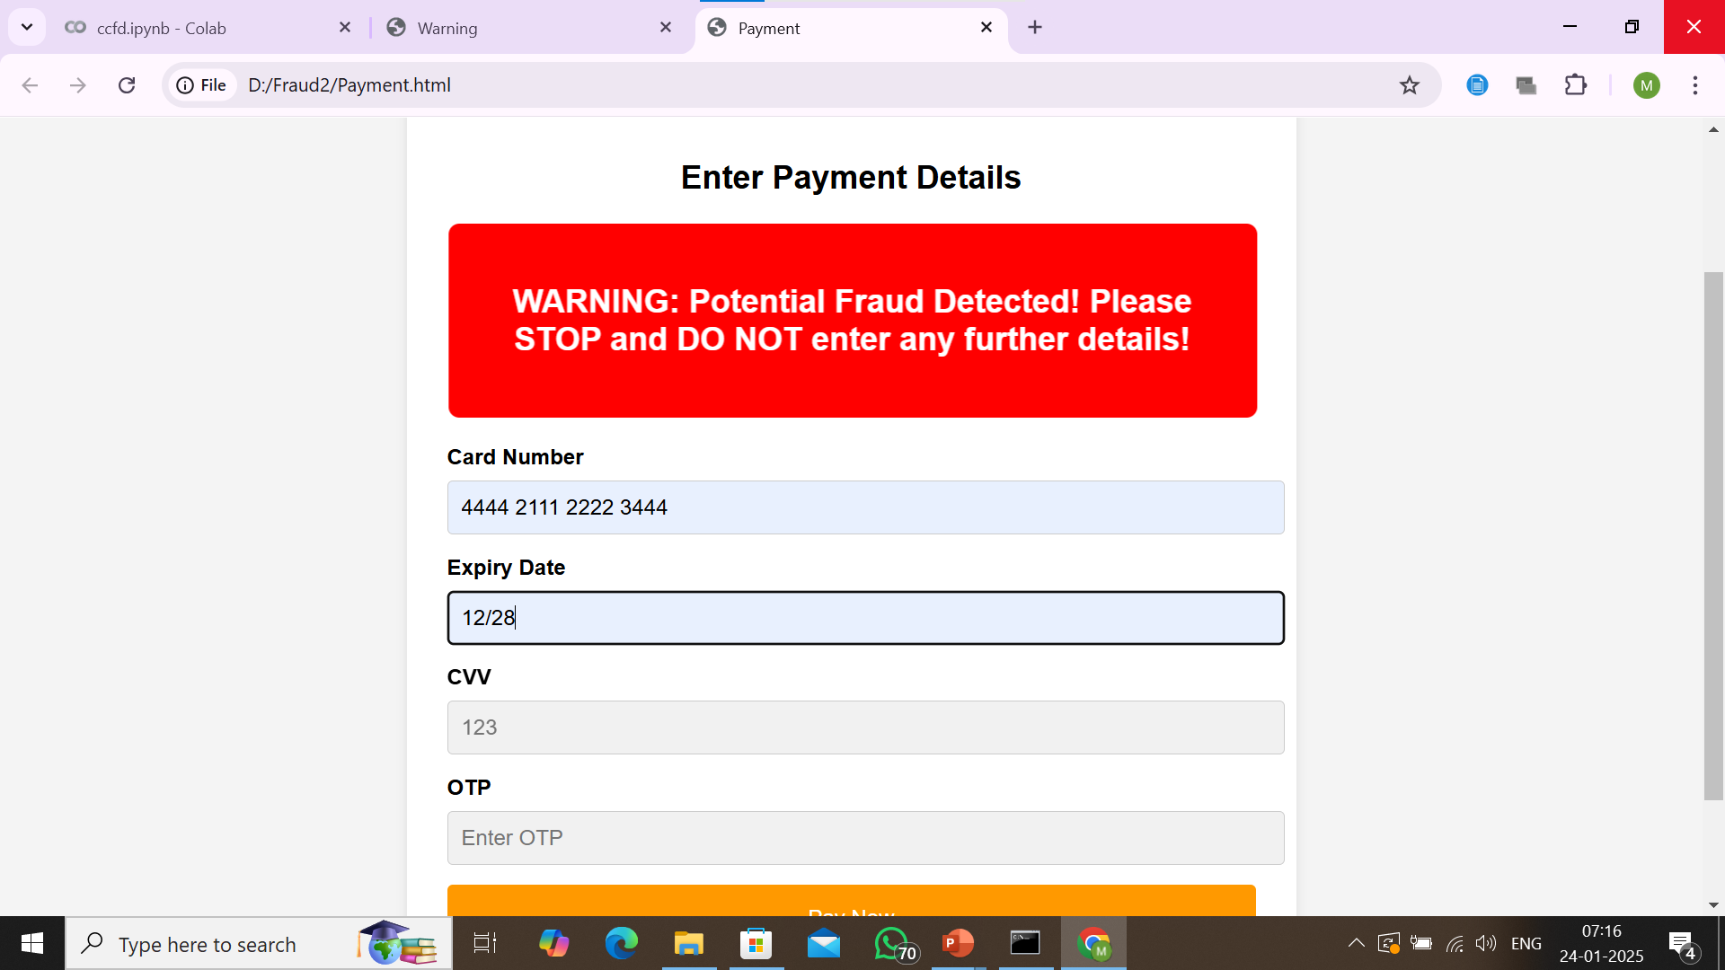
RESULTS
Results
6. Detection of Fraudulent Activity and not allowing the user to enter the credentials.
25
Dept. of ISE, SIT, Tumkur

Slide 26
RESULTS
Results
Model Performance: The machine learning model achieved an accuracy of over 90%, demonstrating its strong capability in detecting fraud.
Reduction in False Positives: The system effectively minimized false positives, ensuring a smooth transaction experience for legitimate users.
Operational Efficiency: The automated fraud detection system helped reduce manual efforts and response times, improving financial security measures.
Real-Time Detection Success: The system successfully flagged fraudulent transactions in real time, showcasing its practical usability in financial environments.
26
Dept. of ISE, SIT, Tumkur

Slide 27
CONCLUSION
Conclusion
Proven Effectiveness: The project confirms that ML-based fraud detection is a reliable solution for financial security challenges.
Future Potential: The system can be further improved by integrating behavioral analytics and real-world deployment.
Scalability and Adaptability: The model can be scaled and adapted to evolving fraud patterns, making it a long-term solution.
Industry Readiness: With proper enhancements, the system can meet industry standards and be deployed across different financial sectors​
27
Dept. of ISE, SIT, Tumkur

Slide 28
FUTURE SCOPE
Future Scope
Behavioral Analytics Integration: Introducing behavioral analysis to monitor user activities over time, identifying unusual patterns that may indicate fraudulent behavior. This will enhance fraud detection accuracy and further reduce false positives.
Real-World Implementation: Deploying the system in real-time financial environments to test its performance with live transaction data. Continuous improvement based on user feedback and evolving fraud patterns.
Adaptive Machine Learning Models: Developing self-learning models that automatically update based on new fraud trends and patterns. Ensuring the system remains effective against constantly changing fraud techniques.
Cloud-Based Scalability: Expanding the system to handle large transaction volumes using cloud infrastructure for scalability and better performance.
28
Dept. of ISE, SIT, Tumkur

Slide 29
FUTURE SCOPE
Future Scope
Cross-Domain Application: Applying the fraud detection system in other domains such as e-commerce, insurance, and healthcare to combat fraudulent activities across industries.
Enhanced Security Measures: Implementing advanced encryption and authentication techniques to protect sensitive transaction data while ensuring compliance with financial regulations.
User-Friendly Dashboard and Reporting: Developing an intuitive dashboard for real-time monitoring, analytics, and automated reporting to help organizations make informed decisions
29
Dept. of ISE, SIT, Tumkur

Slide 30
REFERENCES
References
Almeida, F., & Lima, L. (2022). “An AI-Driven Approach for Fraud Detection in Financial Transactions.” IEEE Transactions on Information Forensics and Security, 17(5), 1153-1165.
Sharma, R., & Gupta, M. (2023). “Real-Time Fraud Detection Using Machine Learning Techniques.” Journal of Financial Crime, 30(2), 329-345.
Kumar, A., & Patel, S. (2023). “Enhancing Fraud Detection Accuracy with Neural Networks.” International Journal of Computer Applications, 179(1), 12-18.
Zhou, Y., & Wang, X. (2023). “Cloud-Based Solutions for Scalable Fraud Detection Systems.” Journal of Cloud Computing: Advances, Systems and Applications, 12(1), 1-15.
30
Dept. of ISE, SIT, Tumkur

Slide 31
Thank You one & all

